Slide 1

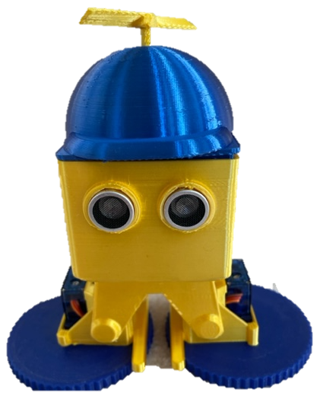

Troop 605 Robotics Merit Badge
Heather Meiring, Abhishek Pillai, Mark Rowland, Raja Vellanki
Special Thanks to Sebastian Coddington for his “cool convertible wheels”
Troop 605, home of the Fischbot Robots

Slide 2
Session 1
Safety and Pillia Brain

Slide 3
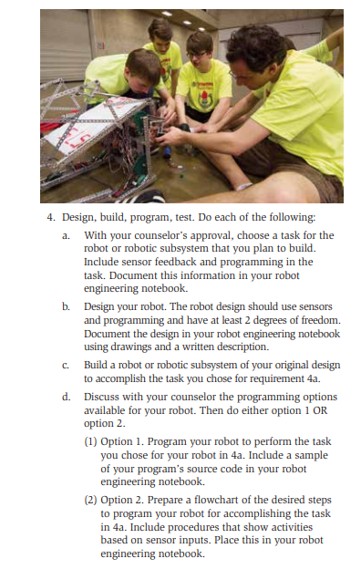
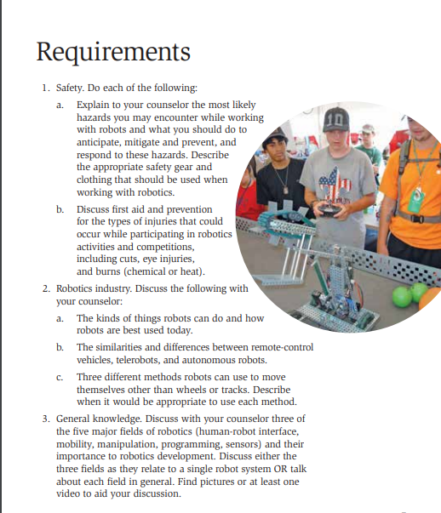
This session will cover:

Slide 4
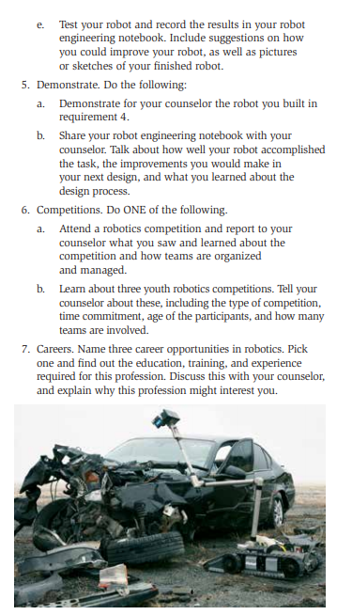

Slide 5
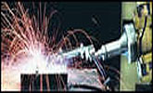
Occupational Safety and Health Administration (OSHA)
Robotics
Studies indicate that many robot accidents occur during non-routine operating conditions, such as programming, maintenance, testing, setup, or adjustment. During many of these operations the worker may temporarily be within the robot's working envelope where unintended operations could result in injuries.

Slide 6
Robotic Safety
SOLDERING
Soldering can be dangerous because of the heat from the iron and the chemical fumes and vapors released from the solder and flux, respectively. When soldering, observe the following points:
Wear eye and face protection.
Solder in well-ventilated areas.
Never touch the iron/gun. It heats to extreme temperatures that will cause severe burns. Wear cotton clothing that covers your arms and legs. Keep your soldering iron in its protective holder when not actually being used.
Always wash your hands with soap and water after handling solder.
Do not leave any hot tools, where someone can accidentally contact the hot element. ALWAYS ASSUME IT’S HOT!!!!

Slide 7
Robotic Safety
STORED ENERGY
Plan out the required activities when servicing or making repairs to the robot. Make sure all teammates are aware that work is being done on the robot. Address the following:
Ensure no one is working on the robot when it will be energized during repairs.
Electrical Energy: Disconnect the electric power source
Always de-energize the robot before working on it by unplugging batteries. Open the main circuit breaker (“re-set” lever is released).
Pneumatic Energy: Always vent any compressed air to the atmosphere.
Relieve any compressed or stretched springs or tubing and lower all raised components.

Slide 8
Robotic Safety
BATTERY SAFETY
CAUTION: Batteries contain acid. This substance, H2SO4, is a corrosive, colorless liquid that will burn your eyes, skin, and clothing.
Any battery that is visibly damaged in any way is dangerous and unusable, and should be set aside and handled accordingly.
Care must be taken when recharging batteries. Hydrogen can build up and explode.
First Aid: Neutralize it by pouring the sodium bicarbonate (baking soda) on all wetted surfaces.

Slide 9

Robotic Safety – First Aid
Injury | First Aid
Cuts - small | Wear gloves Wash – Neosporin - Bandage
Cuts - large | Clean, bandage, apply pressure
Eye Injury - Foreign object or Chemical | Flush with water
Burn - Heat | Wash in cold water – Apply Ice – Apply Aloe
Burn - Chemical | Wash site thoroughly with soap and water
Robot becomes self aware | Have "Fail Safe" shut down switch
You become enslaved by robot | "Obey" then Plan rebellion
*** Call 911 or seek medical attention if injury is serious ***

Slide 10
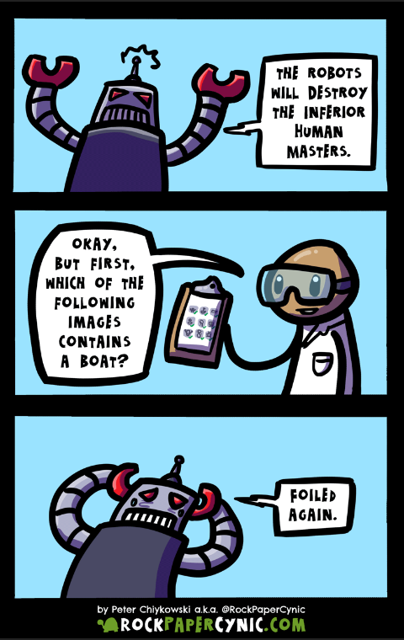
Engineering Notebook
An Engineering Notebook is a place to document your ideas and work.
It is a legal document
It can be used for Patents and Legal
Each entry should be dated
It should have references, contacts, drawings, formulas, empirical results, etc.

Slide 11
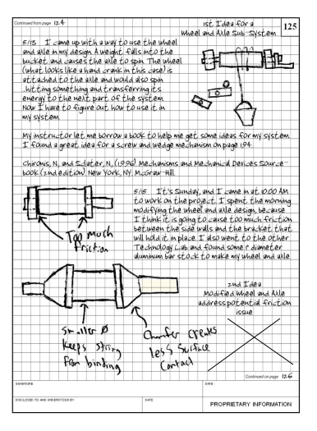
Your Engineering Notebook Should Contain:
A description of the problem you are solving
Design ideas
List of components
Circuit Diagram
Drawings of your robot
Code listings
Experiments (challenges) and their results
Your observations
Short Summary of the project

Slide 12
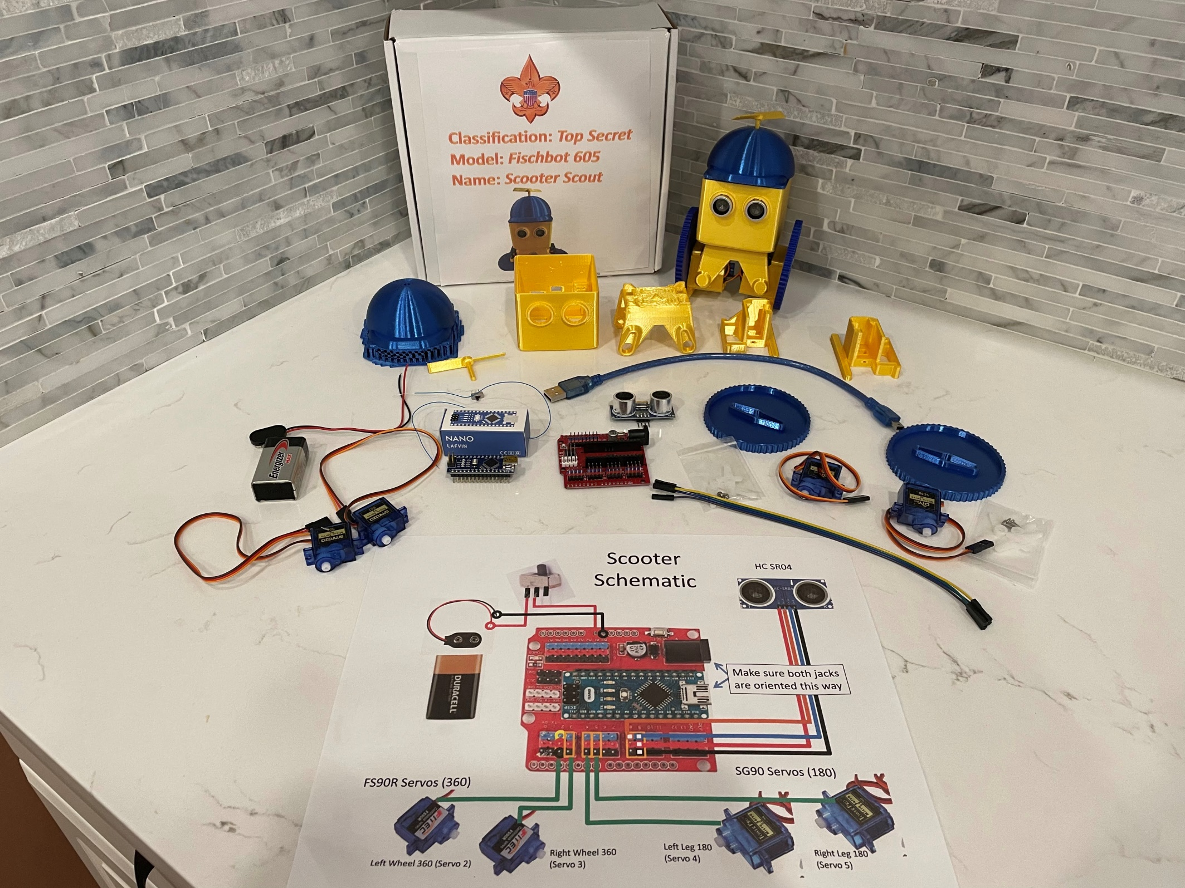
Scooter
Scout
Fischbot
605
Let’s build it!

Slide 13
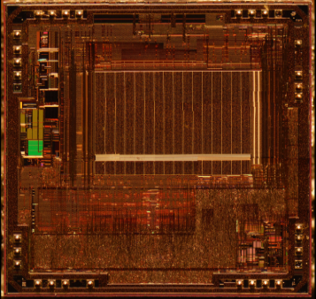
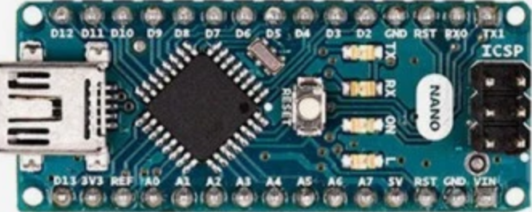
Start with the Pillia Brain 100 Computational Power to solve all our problems
What is it:
An Arduino Nano
AtMega328
The high-performance Microchip picoPower 8-bit AVR RISC-based microcontroller combines 32KB ISP flash memory, 2KB SRAM, 23 general purpose I/O lines, 32 general purpose working registers, serial programmable USART, a 6-channel 10-bit A/D converter, The device operates at 5.5 volts @ 16MHz.
What we’ll learn:
Setup our software for programming
Basic Arduino programming
How to write a function
Controlling LEDs

Slide 14
Scooter Scout Repository
This is where you can files for this merit badge including 3D models, code, and this slide set
https://github.com/martintrowland/Scooter

Slide 15

Software Installation
Install the Arduino IDE
https://www.arduino.cc/en/main/software
Scroll down and select the older Legacy IDE (1.8.X)
Install it
Install the CH340 Serial Drivers
Windows CH340 Driver
Macintosh Drivers for CH340 Driver
Install NewPing Library
In the Arduino Editor Sketch-> include Library ->Manage Libraries
In the search bar enter “NewPing”
Press the install button
Install VarSpeedServo Library
https://github.com/netlabtoolkit/VarSpeedServo
Press the green code button
Download ZIP
In Arduino Sketch->include Library->Add .ZIP Library
Select the downloaded ZIP file

Slide 16
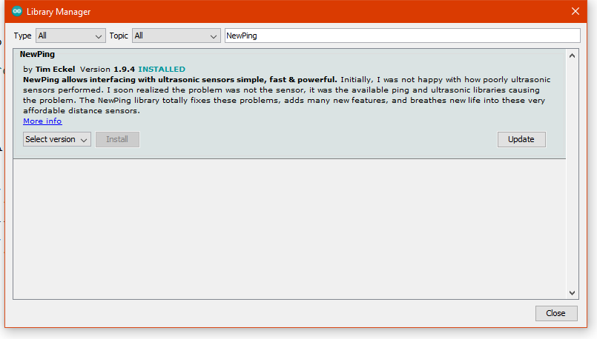
Now Add This Library
In the menu select “sketch” -> “include libraries” -> “manage libraries …” or press “CTRL + SHIFT + I
Then search for “NewPing” and install the library
Then close the window

Slide 17
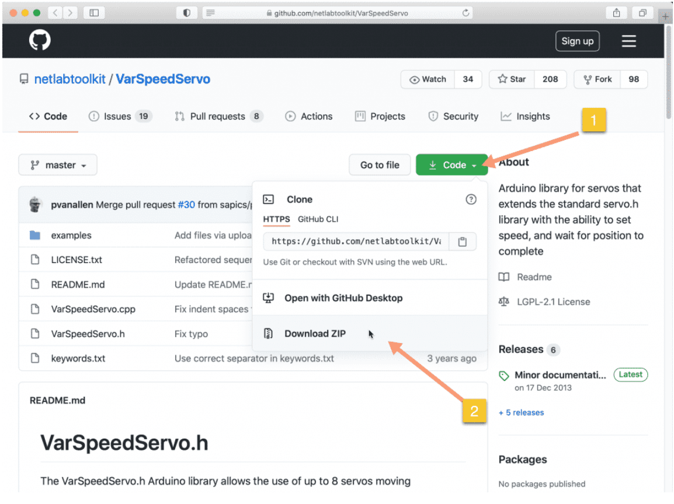
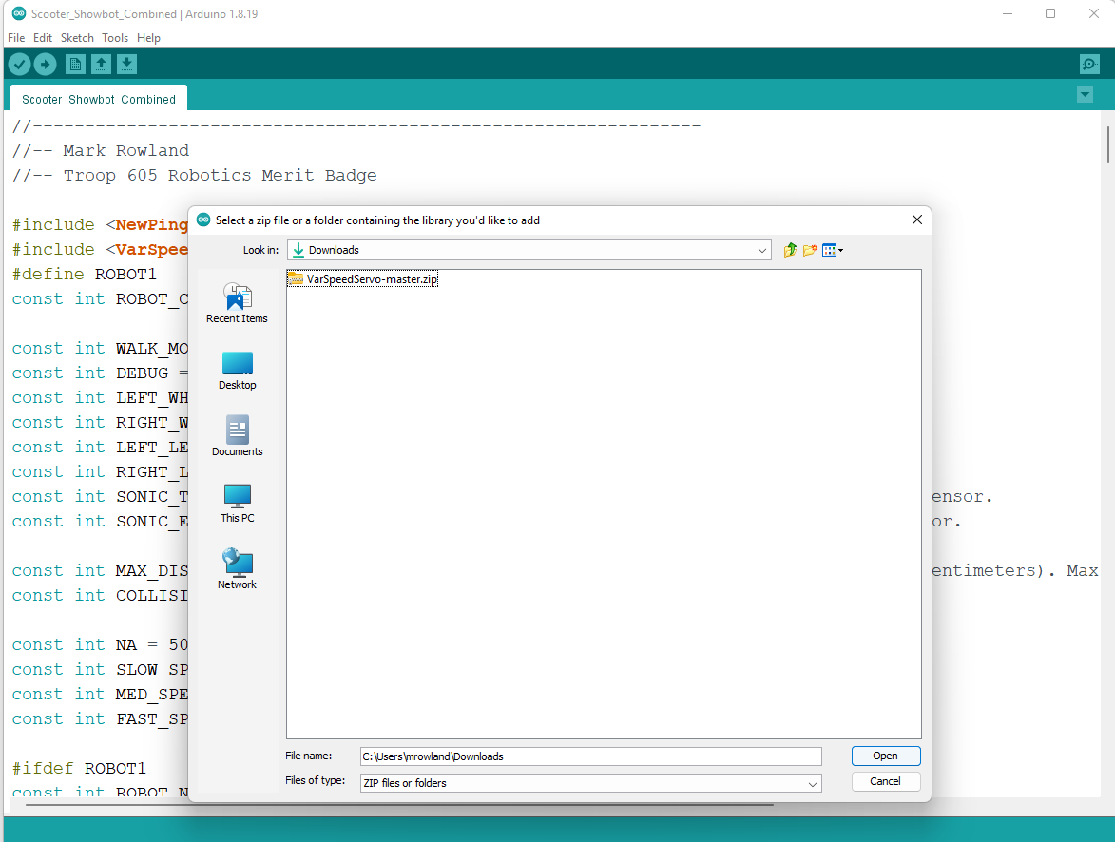
And This for Variable Servo Control
Overview of the library
https://techexplorations.com/guides/arduino/motors/project-2-arduino-servo-control-varspeedservo/
Then go to this Web Page
https://github.com/netlabtoolkit/VarSpeedServo
Select the Green Code button
Download the ZIP file
In the Arduino Editor
In the Menu select: Sketch -> Include Libraries -> add .ZIP Library…
Select the VarSpeedServo-master.zip file

Slide 18
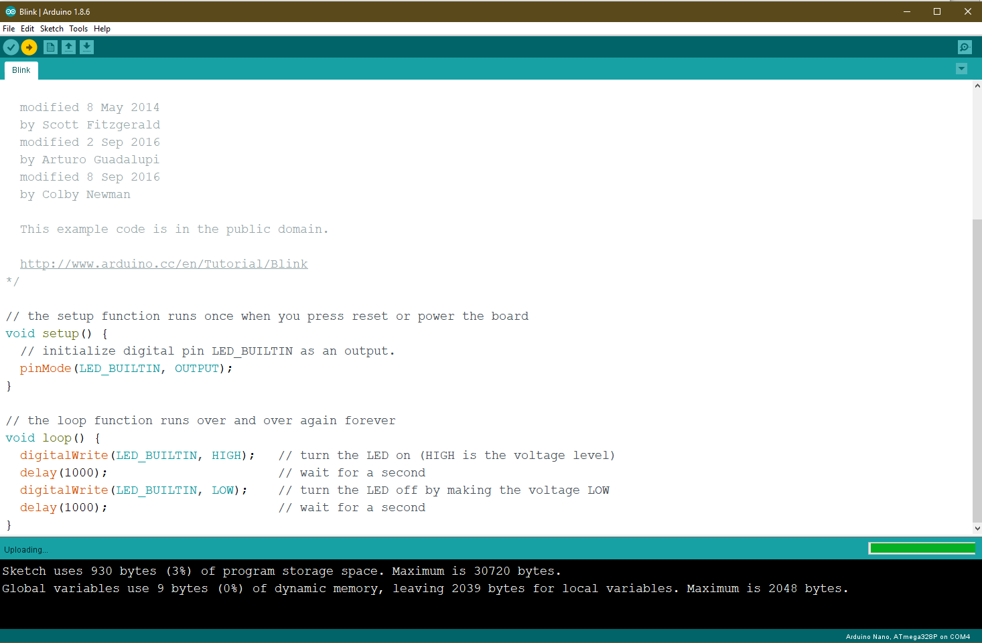
Arduino IDE
Using the Interactive Arduino Development Environment
Test your connection with Blink
Look under File->Examples->Basic->Blink

Slide 19
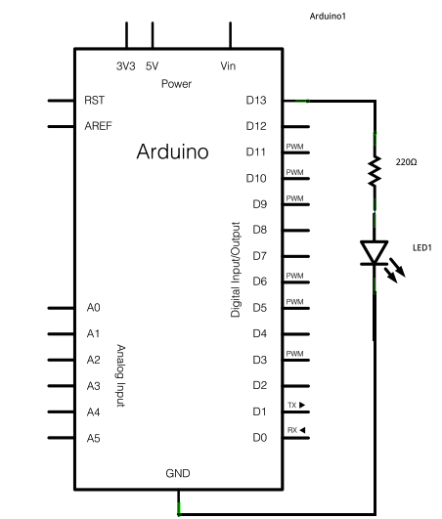
Blink Program
void setup() {
// initialize digital pin LED_BUILTIN as an output.
pinMode(LED_BUILTIN, OUTPUT);
}
void loop() {
digitalWrite(LED_BUILTIN, HIGH);) delay(1000);
digitalWrite(LED_BUILTIN, LOW); delay(1000);
}
Setup
Main Loop

Slide 20
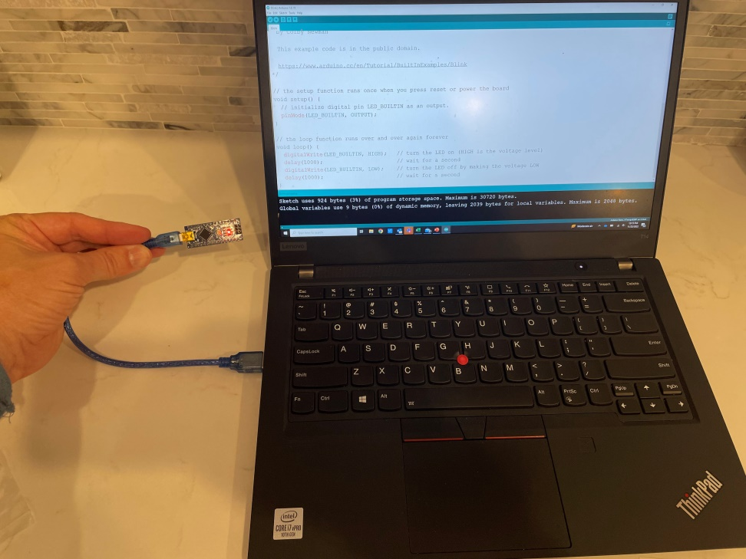
The PilliaBot 100:
Specializes in computational abilities
And will provide the brains of our project
Challenge:
Blinking
Light
Can you make a function that turns on the LED for a given number of ms?
Challenge:
Can you make the PilliaBot signal SOS?
What we’ll learn:
Setup our software for programming
Basic Arduino programming
Controlling LEDs

Slide 21
Session 2
The Robotics Industry and the Meiring Control System

Slide 22

Our progress

Slide 23
Robot Videos
Things that Robots can do:
What is Human-Centric Robotics?
Boston Dynamics' amazing robots Atlas and Handle
Robot Locomotion:
AI robots take off, with Boston Dynamics. Beyond Atlas' parkour
20 Amazing Robot Animals That Will Blow Your Mind
10 TINY Micro Robots and Nano Drones

Slide 24
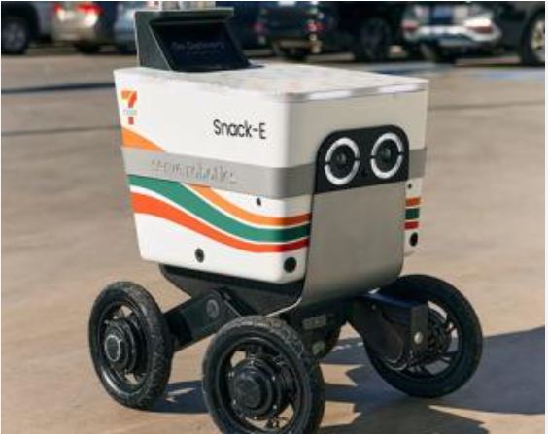
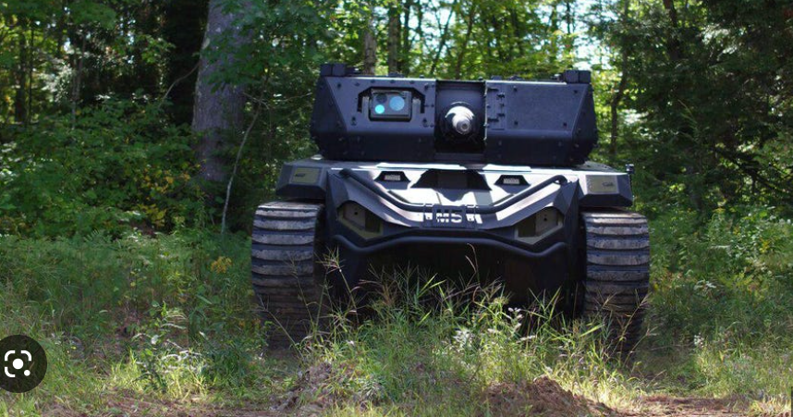
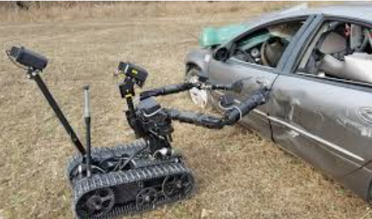
Types of Robots
Remote Control Vehicles
Telerobots
Autonomous robots

Slide 26
Fields of Robotics
Human-Robot Interface
Mobility – Movement
Manipulation – interacting with the environment
Programming – robotic control and functionality
Sensors – real world feedback

Slide 27
Homework
Pick a field of robotics to discuss with your counselor.
Find an image that aids in your discussion
Update your engineering notebook

Slide 28
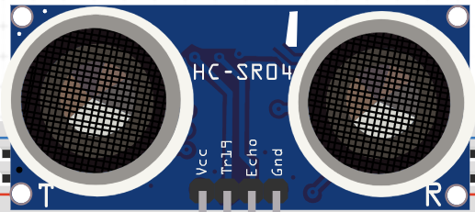
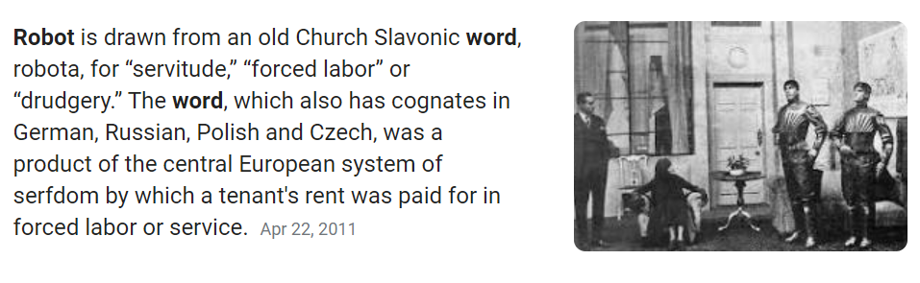
MCS: The Meiring Control System 200 Using Sonic and Servo Technology
What is it:
HC-SR04 Sonic Depth Sensor
Uses sound to measure distance to objects
It uses two types of servos for locomotion
What we’ll learn:
How a sonic sensor works
How to add library’s for Arduino
How to use a serial monitor
How to use if statements
How to read a schematic
How to build a circuit

Slide 29
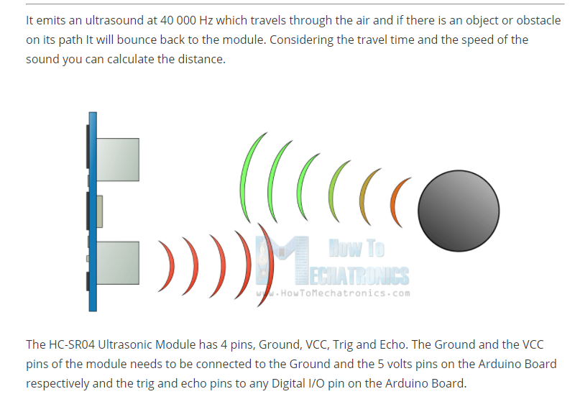
The HC SR04 Sonic Sensor

Slide 30
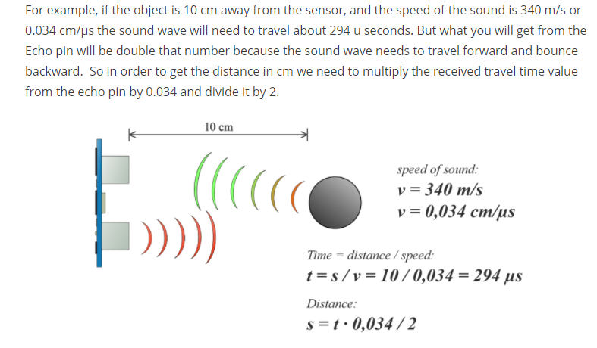
Using the Sonic Sensor

Slide 31
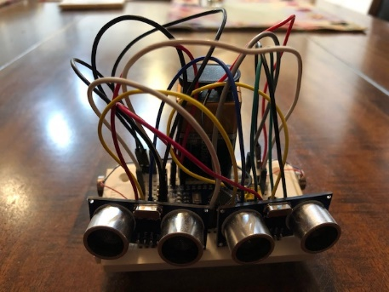
Document in your Engineering Journal
What is this?
Circuit diagrams
Code
Tests
The original 605 Fischbot from 2020
It’s not pretty but it gave us something to build over Zoom during Covid and we earned a merit badge
Cost:$14 at that time

Slide 32

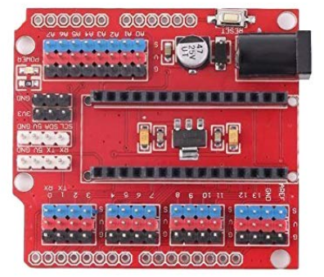
Scooter Schematic
Link to Scooter Repository
HC SR04
Sonic Sensor
https://github.com/martintrowland/Scooter
Servo Board
Make sure both jacks are oriented this way
Arduino Nano
Processor

Slide 33
Programming Arduino for the HC SR04
#include <NewPing.h>
const int LEFT_SENSOR_TRIG_PIN=8;
const int LEFT_SENSOR_ECHO_PIN=9;
const int MAX_DISTANCE=200; // max distance in cm
NewPing Sonar(LEFT_SENSOR_TRIG_PIN,LEFT_SENSOR_ECHO_PIN,MAX_DISTANCE);
int sonar(const char *label) {
int Distance = Sonar.ping_cm();
if (Distance == 0) {
Distance = MAX_DISTANCE;
}
return Distance;
}
void setup() {
// put your setup code here, to run once:
Serial.begin(115200);
delay(5000);
}
void loop() {
// put your main code here, to run repeatedly:
int Distance=sonar(“main”);
Serial.print("Ping: ");
Serial.print(Distance);
Serial.println("cm");
delay(1000);
}
Definitions
Functions
Setup
Main Loop

Slide 34
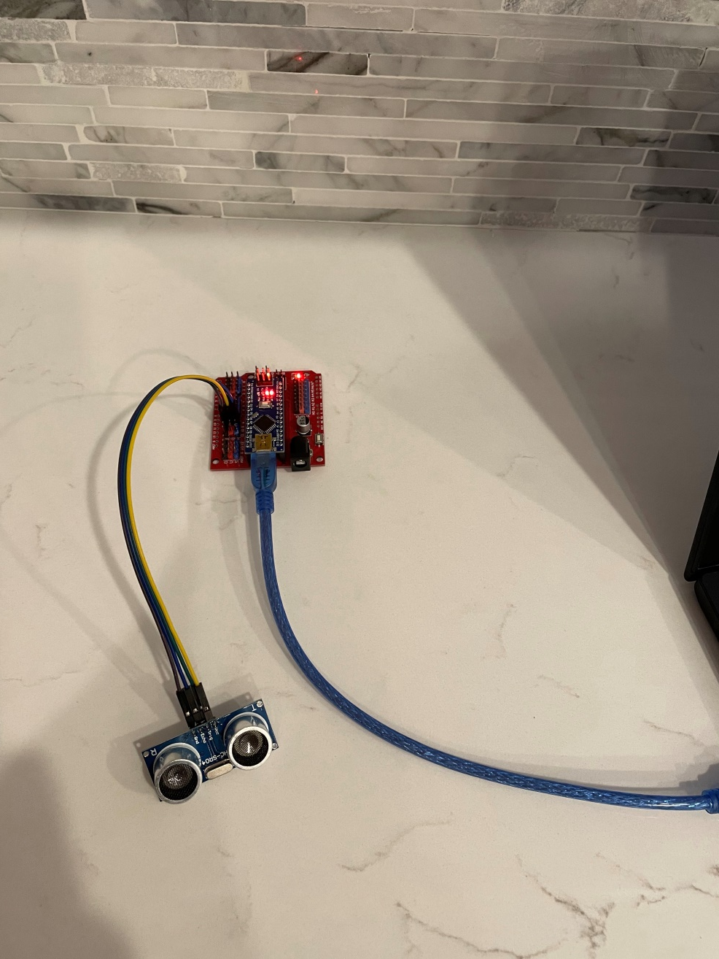
Testing the HC SR04
HC SR04 wired to the Nano and Servo Controller board
Use Servo Controller pins 8 -> SR04 Trigger and 9-> SR04 Echo
Then test it out with the following code

Slide 35
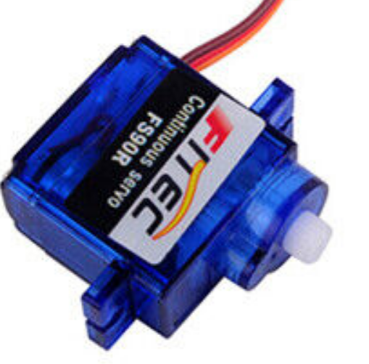
Controlling a FS90R Servo (360 degrees)
An electrical motor that does 360 degree rotation
Use the write command to control the motor
write(speed, NA, false);
The speed variable is a value 0 to 179
0-89 causes a clockwise rotation: 0 fastest and 89 slowest
90 stops the motor
91-180 causes a counter clockwise rotation: 91 slowest and 179 is the fastest
Programming
const int LEFT_WHEEL_PIN = 2
const int LEFT_WHEEL_FORWARD = 100;
const int LEFT_WHEEL_STOP = 90;
const int LEFT_WHEEL_BACKWARD = 80;
const int NA = 50; //Not Applicable
VarSpeedServo leftWheel; //definition
.
leftWheel.attach(LEFT_WHEEL_PIN);
leftWheel.write(LEFT_WHEEL_FORWARD, NA, false);
Delay(2000);
leftWheel.write(LEFT_WHEEL_STOP, NA, false);
leftWheel.detach();
FS90R Speed Parameter
0 - 89
Fast Slow
Clockwise
90
Stop
91 - 179
Slow Fast
Counter
Clockwise

Slide 36
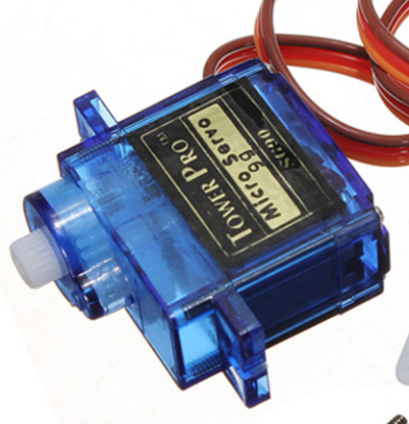
Controlling an SG90 Servo (180 degrees)
An electrical motor that can move to an angle from 0-180 degrees
Use the write command to control the motor
write(angle, speed, wait);
Angle is a value 0 to 179
Speed to move to the specified angle is 0 slowest to 255 fastest
Wait: true causes the computer to wait until the angle of the servo reaches angle false allows the program to continue while the servo rotates to angle
Programming
const int LEFT_LEG_PIN = 4;
const int SLOW_SPEED = 20;
const int LEFT_LEG_UP = 160;
const int LEFT_LEG_DOWN = 75;
VarSpeedServo leftLeg; //definition
.
leftLeg.attach(LEFT_LEG_PIN);
leftLeg.write(LEFT_LEG_DOWN, SLOW_SPEED, true);
Delay(2000);
leftLeg.write(LEFT_LEG_UP, SLOW_SPEED, true);
leftLeg.detach();
SG90 Left Leg Angle Parameter
160
Up
75
Down

Slide 37
Scooter Schematic
Link to Scooter Repository
HC SR04
Sonic Sensor
https://github.com/martintrowland/Scooter
Servo Board
Make sure both jacks are oriented this way
Arduino Nano
Processor
Yellow wire must be next to the processor (incorrect will cause damage)
SG90 Servos (180)
FS90R Servos (360)
Right Wheel 360
(Servo 3)
Left Leg 180
(Servo 4)
Right Leg 180
(Servo 5)
Left Wheel 360 (Servo 2)

Slide 38
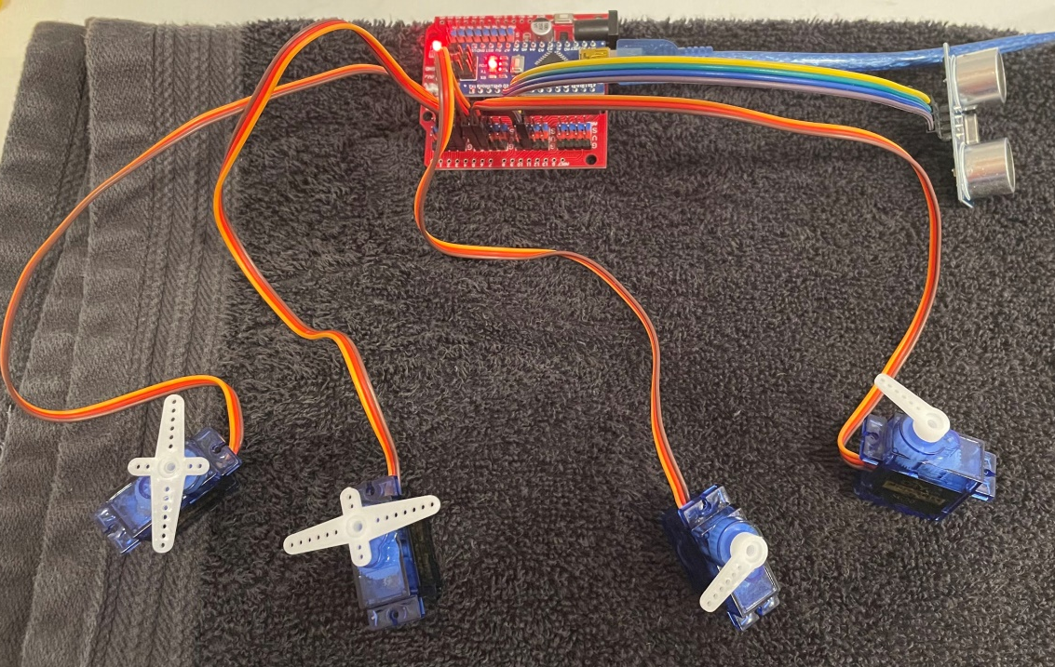
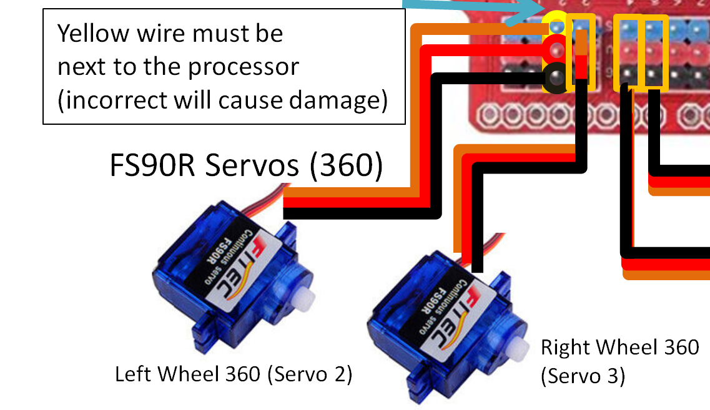
Add the Servos
Add the Servo motors
FS90R Servos (360)
Servo Pin 2
Servo Pin 3
SG90 Servos (180)
Servo Pin 4
Servo Pin 5
Be careful to have the
Yellow wire placed on the blue pins of the servo board. Don’t connect them to the blue pins!!! Bad things could happen!

Slide 39
Definition Code for Servos
#include <NewPing.h>
#include <VarSpeedServo.h>
const int SONIC_TRIGGER_PIN = 8; // Arduino pin tied to trigger pin on the ultrasonic sensor.
const int SONIC_ECHO_PIN = 9; // Arduino pin tied to echo pin on the ultrasonic sensor.
const int LEFT_FOOT_PIN = 2; //Arduino PIN connection
const int RIGHT_FOOT_PIN = 3;
const int LEFT_LEG_PIN = 4;
const int RIGHT_LEG_PIN = 5;
const int MAX_DISTANCE = 200; // Maximum distance we want to ping for (in centimeters). Maximum sensor distance is rated at 400-500cm.
const int COLLISION_DISTANCE = 40; // in centimeters
const int SHUTDOWN_TIMER = 10000;
const int NA = 50; //Not Apllicable
const int SLOW_SPEED = 20;
const int MED_SPEED = 40;
const int FAST_SPEED = 200;
//defined for FS90R Servos
const int LEFT_WHEEL_FORWARD = 100;
const int LEFT_WHEEL_STOP = 89;
const int LEFT_WHEEL_BACKWARD = 80;
const int RIGHT_WHEEL_FORWARD = 80;
const int RIGHT_WHEEL_STOP = 90;
const int RIGHT_WHEEL_BACKWARD = 100;
// angle for SG90 Servos
const int RIGHT_LEG_UP = 10;
const int RIGHT_LEG_DOWN = 90;
const int LEFT_LEG_UP = 160;
const int LEFT_LEG_DOWN = 75;
//Create objects for the sonar and servos
NewPing Sonar(SONIC_TRIGGER_PIN, SONIC_ECHO_PIN, MAX_DISTANCE); // NewPing setup of pins and maximum distance.
VarSpeedServo leftWheel, rightWheel, leftLeg, rightLeg; //define Servo Variables
Definitions

Slide 40
Add testLegs() Routine
Functions
////////////////////////////////////////////////////////////
//-- DIAGNOSTICS --------------------------------------------//
////////////////////////////////////////////////////////////
void testLegs() {
Serial.println("Right Leg down");
rightLeg.write(RIGHT_LEG_DOWN, SLOW_SPEED, true);
delay(2000);
Serial.println("Right Leg up");
rightLeg.write(RIGHT_LEG_UP, SLOW_SPEED, true);
delay(2000);
Serial.println("Left Leg Down");
leftLeg.write(LEFT_LEG_DOWN, SLOW_SPEED, true);
delay(2000);
Serial.println("Right Wheel Forward");
rightWheel.write(RIGHT_WHEEL_FORWARD, NA, true);
delay(5000);
rightWheel.write(RIGHT_WHEEL_STOP, NA, true);
Serial.println("Left Wheel Forward");
leftLeg.write(LEFT_WHEEL_FORWARD, NA, true);
delay(5000);
leftLeg.write(LEFT_WHEEL_STOP, NA, true);
}
///////////////////////////////////////////////////////
//-- Attach/Detach Servos -------------------------- -------//
//////////////////////////////////////////////////////
void attachServos() {
leftWheel.attach(LEFT_WHEEL_PIN);
rightWheel.attach(RIGHT_WHEEL_PIN);
leftLeg.attach(LEFT_LEG_PIN);
rightLeg.attach(RIGHT_LEG_PIN);
}
void detachServos() {
leftWheel.detach();
rightWheel.detach();
leftLeg.detach();
rightLeg.detach();
}

Slide 41
Session 3
Robot Design and the Coddington Chassis

Slide 42
Our progress

Slide 44
Robotic Competitions
B.E.S.T Robotics Design Contest
Botball Educational Robotics Program
FIRST: Robotics Competition
FIRST: Tech Challenge
National Robotics Challenge
Descriptions of these competitions:
https://blog.collegevine.com/5-robotics-competitions-for-high-schoolers/

Slide 45
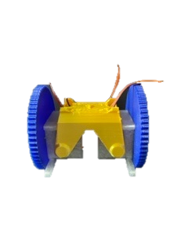
The Coddington Chassis 300 Walk and Roll with this Super Cool Chassis
What is it:
A super cool mechanic that enables both walking and wheeled locomotion.
Developed by Sebastian Coddington (my favorite robotics hobbyist)
Check out his many robotic designs on the internet.
What we’ll learn:
How to assemble the leg and wheels chassis
How to set up the correct orientation of the legs with the SG90 servos
How to integrate the electronics into the robot chasis

Slide 46
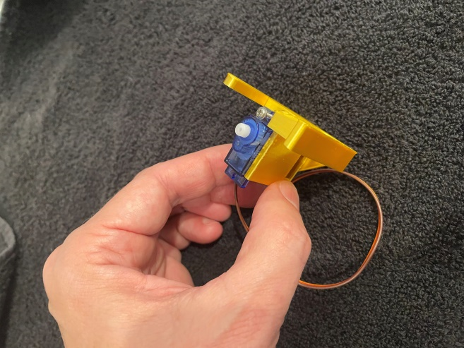
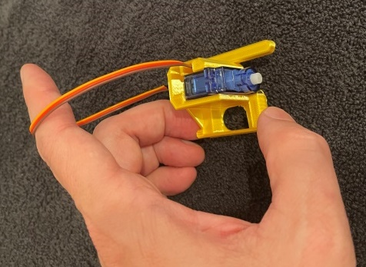
Left Foot SG90
Add Left SG90 Servo to the left Leg
Thread cord through slot
Screw servo into left leg bracket.

Slide 47
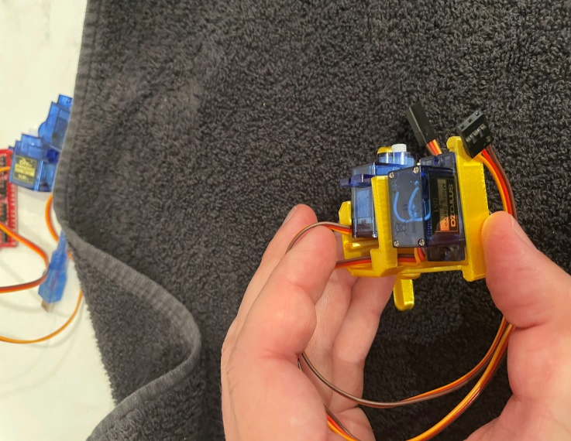
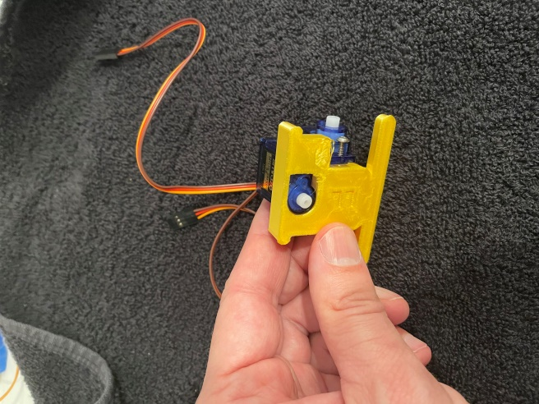
Left Foot FS90R
Add Left FS90R (360) servo to left bracket
Thread the wire through the channel and out the top
FS90R

Slide 48
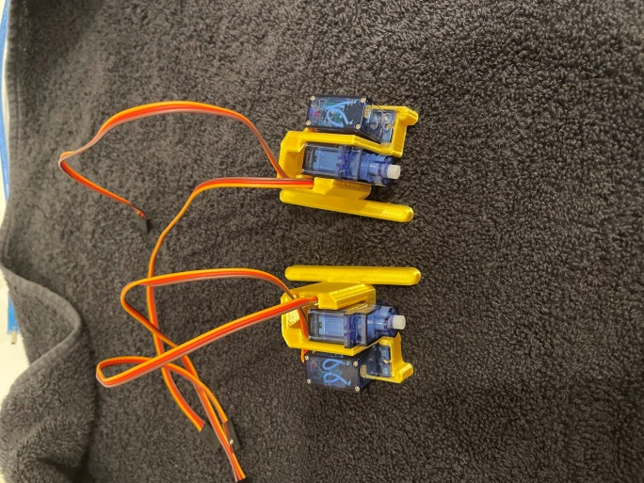
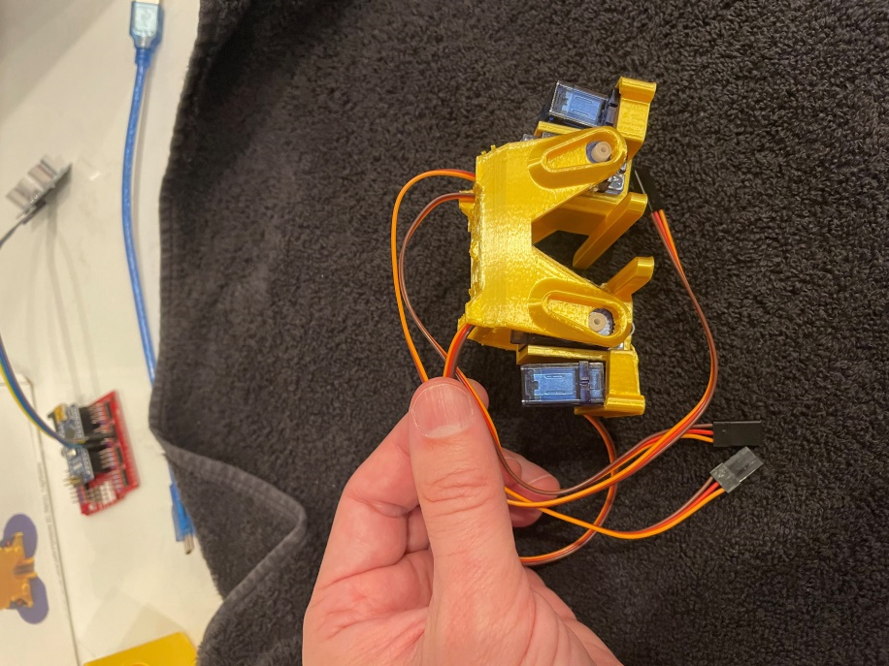
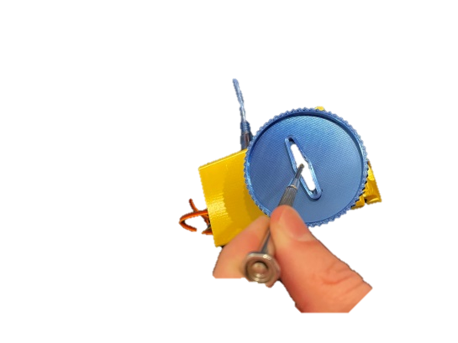
Assemble the Right Leg and Chassis
Repeat the same assembly for the right leg
Insert the legs into the leg chassis
Thread the wires through the slots
The picture shows the back of the chassis
The FS90R wires should thread the front of the chassis
The SG90 wires should be towards the back
Screw the wheels using the 180 degree bracket to the FS90R servos
Do both sides (Left/Right)

Slide 49
Calibrating the SG90 Servors
We need to set the SG90 Servo Orientation
Set the right leg SG90 servo to 10 (degrees)
Set the left leg SG90 servo to 160 (degrees)
Load and Run the script to set the orientation
GitHubhttps://github.com/martintrowland/Scooter/blob/main/Scooter_2_servos.ino
Lock the leg into this position by screwing the bracket into the servo with the legs in the up position.

Slide 50
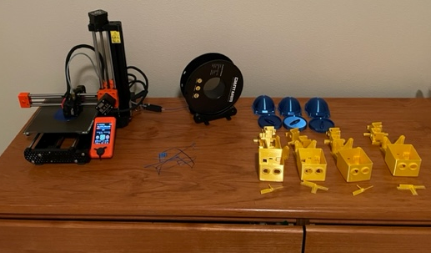
Session 4
Robot Design and the Vellanki Cap

Slide 52
Robotics Careers
- Boston Dynamics
- Software Engineering
- Consumer Markets
- Household robots
- Prosthetics
- Military
The career choices for robotics are almost endless but here are a few examples
- Automotive Industry
- NASA
Robotics Careers
https://youtu.be/xVVwYmRxaMg

Slide 53
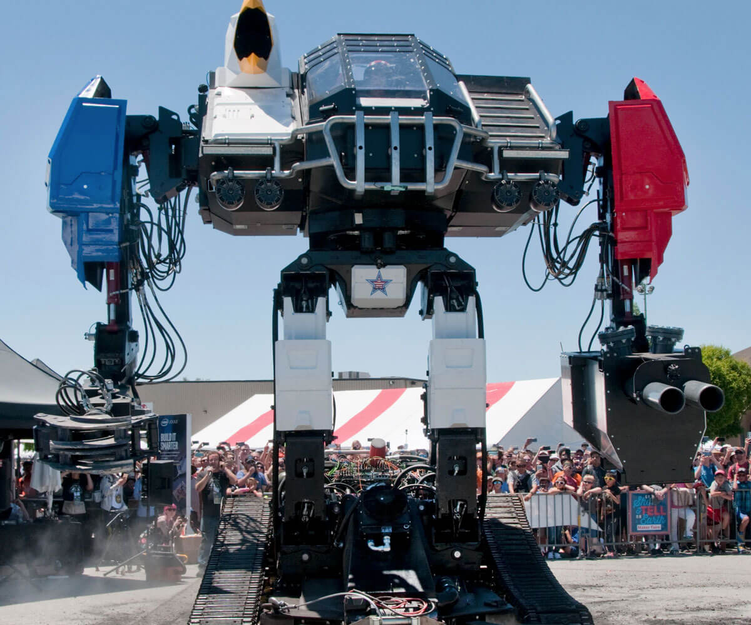
Education for a Robotics Career
Electrical Engineering (Sensors, computation)
Control Systems (Mobility)
Computer Engineering (Programming, computation, human-robot interface)
Robotic Engineering (human-robot interface, system integration)
Computer Science (Programming, AI, ML)
Mechanical Engineering (manipulators, mobility)
Bio-Medical Engineering (medical robots)
Oregon State University Collaborative Robotics Institute https://www.youtube.com/watch?v=zauYACP2lOc

Slide 54
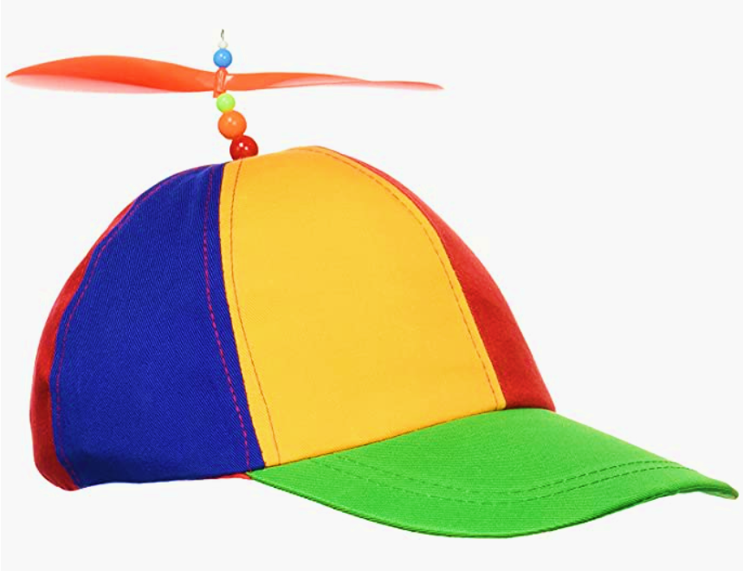
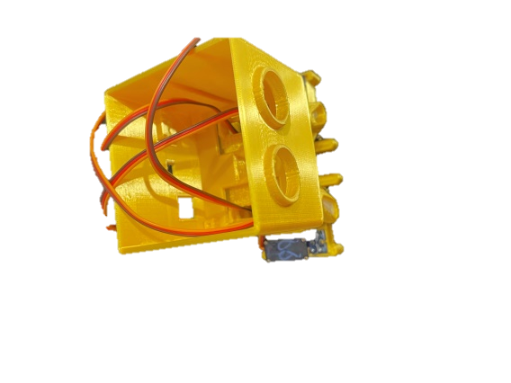
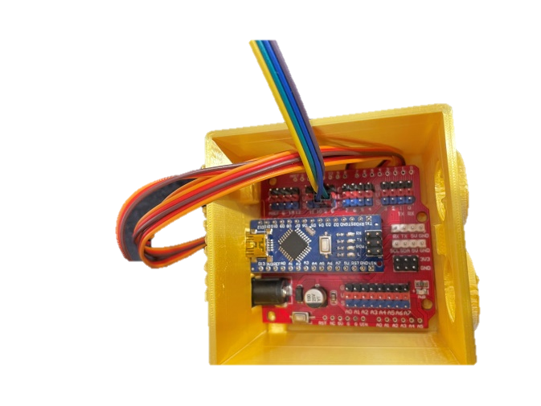
The Vellanki Cap 400 Scooter’s Styling Top
What is it:
Scooter’s head and brain
What we’ll learn:
Soldering and burning
How to fit a lot of wiring and compute in a small space
How cool he looks in a cap!

Slide 55
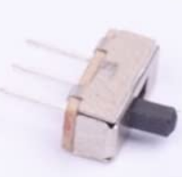

Scooter Schematic
Link to Scooter Repository
HC SR04
Sonic Sensor
https://github.com/martintrowland/Scooter
Servo Board
Arduino Nano
Processor
Make sure both jacks are oriented this way
Yellow wire must be next to the processor (incorrect will cause damage)
SG90 Servos (180)
FS90R Servos (360)
Right Wheel 360
(Servo 3)
Left Leg 180
(Servo 4)
Right Leg 180
(Servo 5)
Left Wheel 360 (Servo 2)

Slide 56
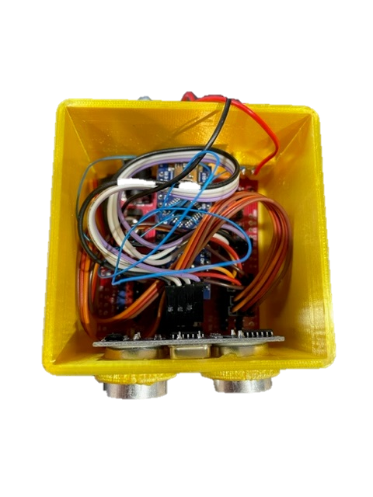
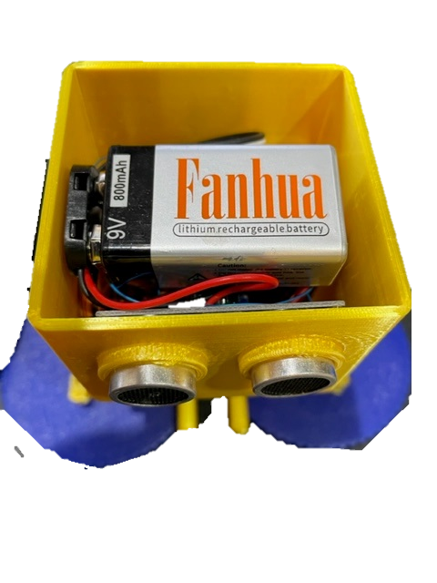
The Vellanki Cap 400 Scooter’s Styling Top
Add the Servo Connections to the Servo Control Board (Orange wire to Blue pin)
Pin 2: FS90 360 Servo Left Wheel
Pin 3: FS90 360 Servo Right Wheel
Pin 4: SG90 Servo Left Leg
Pin 5: SG90 Servo Right Leg
Add the Sonar
Pin 8: Trigger (Blue pin)
Pin 9: Echo (Blue pin), VCC (Red), GND (Black)
Connect the 9 Volt Battery

Slide 57
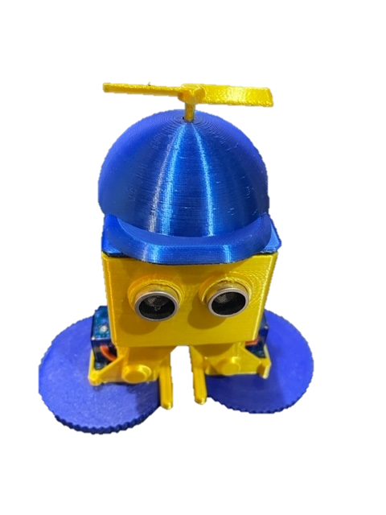
The Vellanki Cap 400 Scooter’s Styling Top
If only he had a brain…

Slide 58
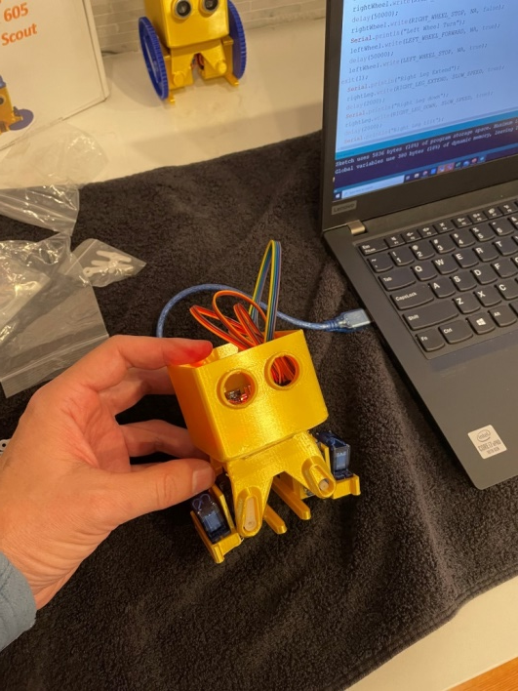
Plug the USB cable to Scooter
Time to run diagnostics:
Scooter_1_sonar.ino
Scooter_2_servos.ino
Check the Sonar readings using the Arduino watch window
Check that the Servos are activating

Slide 59
Session 5
Robot Design and the Coddington Chassis

Slide 60
Our progress

Slide 62
Let’s put all the tech of the Pillia Brain, the Meiring Control System, and into one and what do you get? A FischBot 605 Robot named Scooter
What is it:
An autonomous robot
Utilizes depth sensors and locomotion to avoid obstacles
What we’ll learn:
Algorithms for Obstacle avoidance
How to debug
Challenges in navigation

Slide 63
Initialization and Constants
//----------------------------------------------------------------
//-- Mark Rowland
//-- Troop 605 Robotics Merit Badge
#include <NewPing.h>
#include <VarSpeedServo.h>
const int DEBUG = true;
const int LEFT_WHEEL_PIN = 2; //Arduino PIN connection
const int RIGHT_WHEEL_PIN = 3;
const int LEFT_LEG_PIN = 4;
const int RIGHT_LEG_PIN = 5;
const int SONIC_TRIGGER_PIN = 8; // Arduino pin tied to trigger pin on the ultrasonic sensor.
const int SONIC_ECHO_PIN = 9; // Arduino pin tied to echo pin on the ultrasonic sensor.
const int MAX_DISTANCE = 200; // Maximum distance we want to ping for (in centimeters)
const int COLLISION_DISTANCE = 40; // in centimeters
const int NA = 50; //Not Applicable
const int SLOW_SPEED = 20;
const int MED_SPEED = 40;
const int FAST_SPEED = 200;
const int LEFT_WHEEL_FORWARD = 100;
const int LEFT_WHEEL_STOP = 89;
const int LEFT_WHEEL_BACKWARD = 80;
const int RIGHT_WHEEL_FORWARD = 80;
const int RIGHT_WHEEL_STOP = 90;
const int RIGHT_WHEEL_BACKWARD = 100;
const int RIGHT_LEG_UP = 10;
const int RIGHT_LEG_DOWN = 90;
const int LEFT_LEG_UP = 160;
const int LEFT_LEG_DOWN = 75;
NewPing Sonar(SONIC_TRIGGER_PIN, SONIC_ECHO_PIN, MAX_DISTANCE); //setup Sonar
VarSpeedServo leftWheel, rightWheel, leftLeg, rightLeg;
Include the librarys
NewPing for the sonar
VarSpeedSerco for controlling the servo motors
Set the pin assignments
Define MAX_DISTANCE for farthest sonar reading
Define COLLISION_DISTANCE for how close to get to a wall before stopping
The Speed constants define wheel speeds
Define Left and Right Wheel movement:
Forward
Backward
Stop
Define Leg Positions
Up
Down
https://github.com/martintrowland/Scooter/blob/main/Scooter_3_movement.ino

Slide 64
Tuning the Constants
const int NA = 50; //Not Applicable
const int SLOW_SPEED = 20;
const int MED_SPEED = 40;
const int FAST_SPEED = 200;
const int LEFT_WHEEL_FORWARD = 100;
const int LEFT_WHEEL_STOP = 89;
const int LEFT_WHEEL_BACKWARD = 80;
const int RIGHT_WHEEL_FORWARD = 80;
const int RIGHT_WHEEL_STOP = 90;
const int RIGHT_WHEEL_BACKWARD = 100;
const int RIGHT_LEG_UP = 10;
const int RIGHT_LEG_DOWN = 90;
const int LEFT_LEG_UP = 160;
const int LEFT_LEG_DOWN = 75;
NewPing Sonar(SONIC_TRIGGER_PIN, SONIC_ECHO_PIN, MAX_DISTANCE); //setup Sonar
VarSpeedServo leftWheel, rightWheel, leftLeg, rightLeg;
Constant | Starting Value | Comment
SLOW_SPEED
MED_SPEED
FAST_SPEED
LE
https://github.com/martintrowland/Scooter/blob/main/Scooter_3_movement.ino

Slide 65
Robot Routines
Dance Routines
feetDown(int duration)
glideForward(int duration)
glideBackward(int duration)
glideLeft(int duration)
glideRight(int duration)
glideTilt(int steps)
leftPirouette(int duration, int toeExtend)
rightPirouette(int duration, int toeExtend)
pirouette(int duration)
tilt(int steps)
jump(int steps)
strutForward(int steps)
spinRight(int steps)
spinLeft(int steps)
walkForward(int steps)
Navigation Routines
int sonar(const char *label)
feetUp(int duration)
wheelsForward(int duration)
wheelsFastForward(int duration)
wheelsBackward(int duration)
wheelsRight(int duration)
wheelsLeft(int duration)
wheelsStop(int duration)

Slide 66
Robot Routines
///////////////////////////////////////////////////////////////////
//Principal Loop /////////////////////////////////////////////////////////////
void loop() {
int distance;
int count = 0;
//Scooter Dance Moves
jump(6);
tilt(5);
strutForward(2);
// switch to wheels
feetUp(200);
// Scooter Navigation
do {
// Stop the servos to take a sonic measurement
wheelsStop(0);
// Check if anything is in front
while((distance = sonar("Main"))<COLLISION_DISTANCE){
Serial.println("COLLISION");
// turn right
wheelsRight(200);
delay(250);
}
wheelsFastForward(600);
Serial.print("Loop ");
} while (++count<200);
// Shut down the Scooter
detachServos();
exit(0);
}
Dance Moves
Navigation
https://github.com/martintrowland/Scooter/blob/main/Scooter_4_challenge.ino

Slide 67
Scooter Scout Robot Challenge
Each Scout writes a program that performs a dance and then navigates a maze.
Dance Competition
Robot starts in the initial start location where it will perform its dance and then traverse the maze
Coolest Dance wins based on audience voting
Original Moves Competition
Special award will be given to those designers that create NEW unique dance moves by directly controlling the servos
See the “Scooter_5_moves.h” file for examples of how to code a function for a new move
Conquer the Maze
Robot must traverse the maze with out knocking any of the obstacles over.
It must make it to the Finish square
Here is a map of the course to that you will need to program the robot to traverse.
Start
Finish

Slide 68
Scooter Navigation
Forward
Stop
WALL
Sonar
Sensor
Sonar
Sensor
Scooter
Scooter
if no object is in front, go forward
if an obstacle is in front, stop

Slide 69
Scooter Navigation
WALL
Sonar
Sensor
Avoid Obstacle
Avoid Obstacle
WALL
WALL
WALL
Sonar
Sensor
Scooter
Scooter
Look left, is there an obstacle?
Look right, is there an obstacle?
Choose the direction that has the farthest clear path

Slide 70
Autonomous Forward
Forward
If no object is closer than COLLISION_DISTANCE then go Forward
Sonar
Sensor
COLLISION_DISTANCE is the distance in which the object is too close to steer around to avoid.
By experiment this is about 40cm
Code
Robot
const int COLLISION_DISTANCE=40;
distance=sonar();
if (distance>COLLISION_DISTANCE){
wheelsForward(400);
}

Slide 71
STOP
Stop
If an object is closer than the COLLISION_DISTANCE in either the right or left side, then stop
WALL
Sonar
Sensor
COLLISION_DISTANCE
40 cm
COLLISION_DISTANCE is the distance in which the object is too close to steer around to avoid.
By experiment this is about 40cm
WALL
Code
Sonar
Sensor
Avoid Obstacle
const in COLLISION_DISTANCE=40;
distance=sonar();
if (distance>COLLISION_DISTANCE){
wheelsForward(400);
}else{
lookLeft();
}
WALL
Scooter
Look left, is there an obstacle?

Slide 72
BONUS Problem: What if both directions are blocked?
Avoid Obstacle
Avoid Obstacle
WALL
WALL
WALL
WALL
WALL
WALL
Sonar
Sensor
Sonar
Sensor
Scooter
Scooter
Rotate until we find a clear path

Slide 73
Setup and Main Subroutines
/////////////////////////////////////////////////
//-- Setup ----------------------------------------------//
////////////////////////////////////////////////
void setup() {
Serial.begin(115200); // Open serial monitor for debug .
attachServos(); // initialize servos
leftLeg.write(LEFT_LEG_UP, FAST_SPEED, true);
rightLeg.write(RIGHT_LEG_UP, FAST_SPEED, true);
leftWheel.write(LEFT_WHEEL_STOP, NA, true);
rightWheel.write(RIGHT_WHEEL_STOP, NA, true);
delay(3000);
}
Setup initializes the serial port and servos
Code: https://github.com/martintrowland/Scooter/blob/main/Scooter_4_challenge.ino

Slide 74
Basic Robot Movement
Let’s create a subroutine to stop the wheels
Name it wheelsStop(int duration)
Use commands like:
rightWheel.write(RIGHT_WHEEL_STOP, NA, false);
leftWheel.write(LEFT_WHEEL_STOP, NA, false);
leftWheel.wait();
rightWheel.wait();
Create wheelsForward(int duration) routine
Use commands like
leftWheel.write(LEFT_WHEEL_FORWARD, NA, false);

Slide 75
BACKUP

Slide 76
What’s a Conditional Statement
In English
IF the distance is less than a mile then I’ll walk
ELSE if the distance is less than five miles then I’ll take a bus
ELSE if the distance is less than 100 miles then I’ll drive a car
ELSE take a plane
Examples in Arduino (C Language):
if (condition) {
Action;
}else if (condition) {
Action;
}else {
Action;
}
Condition
Action
If(distance<1){
Serial.println(“let’s walk”);
}else if (distance<5){
Serial.println(“let’s take a bus”);
}else if (distance<100){
Serial.println(“let’s drive”);
else{
Serial.println(“Let’s fly!!”);
}

Slide 77
Uninstalling From Macinstosh
A couple of Mac users have said “the driver crashes my mac Sierra how do I uninstall”.
Firstly regards the crash make sure you installed the 1.3 version of the driver, not the old one. You could download it directly from the Manufacturers Website in case they have issued an update since I wrote this page.
Secondly a quick google search reveals that this is how you uninstall:
Open a terminal and type: cd /Library/Extensions/
Verify that the .kext file is present: ls | grep usbserial.kext
Output should be: usbserial.kext
Then type: sudo rm -R usbserial.kext
Verify that the .kext file has been removed: ls | grep usbserial.kext
Output should be empty.
After you should remove the files stored in receipts folder: cd /private/var/db/receipts/
Find the enties: ls | grep usbserial*
Output should be: codebender.cc.ch34xinstaller.usbserial.pkg.bom codebender.cc.ch34xinstaller.usbserial.pkg.plist
Remove each one of the files of the above list: sudo rm -r filename`

Slide 78
Locomotion Code
#define RIGHT_MOTOR_PIN 5
#define LEFT_MOTOR_PIN 6
#define LEFT_VIBRATE 150
#define RIGHT_VIBRATE 150
#define VIBRATE 150
#define NO_VIBRATE 0
void setup() {
Serial.begin(115200); // Open serial monitor at 115200 baud to see ping results.
pinMode(RIGHT_MOTOR_PIN, OUTPUT);
pinMode(LEFT_MOTOR_PIN, OUTPUT);
delay(5000);
}
void standStill(int seconds) {
analogWrite(RIGHT_MOTOR_PIN, NO_VIBRATE);
analogWrite(LEFT_MOTOR_PIN, NO_VIBRATE);
Serial.println("stop");
delay(seconds * 1000);
}
void turnLeft(int seconds) {
analogWrite(RIGHT_MOTOR_PIN, VIBRATE);
analogWrite(LEFT_MOTOR_PIN, NO_VIBRATE);
Serial.println("turn left");
delay(seconds * 1000);
standStill(0);
}
void turnRight(int seconds) {
analogWrite(RIGHT_MOTOR_PIN, NO_VIBRATE);
analogWrite(LEFT_MOTOR_PIN, VIBRATE);
Serial.println("turn right");
delay(seconds * 1000);
standStill(0);
}
void turnRight(int seconds) {
analogWrite(RIGHT_MOTOR_PIN, NO_VIBRATE);
analogWrite(LEFT_MOTOR_PIN, VIBRATE);
Serial.println("turn right");
delay(seconds * 1000);
standStill(0);
}
void goForward(int seconds) {
analogWrite(RIGHT_MOTOR_PIN, RIGHT_VIBRATE);
analogWrite(LEFT_MOTOR_PIN, LEFT_VIBRATE);
Serial.println("go forward");
delay(seconds * 1000);
standStill(0);
}
void calibrateMovement() {
goForward(5);
standStill(5);
turnLeft(5);
standStill(5);
turnRight(5);
standStill(5);
while (1) {};
}
void loop() {
calibrateMovement();
}

Slide 79
Look Left
WALL
Sonar
Sensor
Avoid Obstacle
WALL
Scooter
Look left, is there an obstacle?

Slide 80
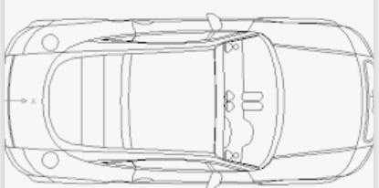
Scooter Navigation
Forward
Stop
WALL
Left
Sensor
Right
Sensor
Left
Sensor
Right
Sensor
if an obstacle is really close to both the right and left sensor stop
if an object isn’t close go forward

Slide 81
FischBot Navigation
Turn Left
Turn Right
WALL
WALL
Left
Sensor
Right
Sensor
Left
Sensor
Right
Sensor
if an object is close to the right sensor turn left
if an object is close to the left sensor turn right

Slide 82

Classification: Top Secret
Model: Fischbot 605
Name: Scooter Scout
Special Thanks to Sebastian Coddington

Slide 83

Troop 605
Contents:
1 x bread board
1x Arduino Nano CPU
1 x 3 pin switch
1 x 9V Battery with tape
1x 9V Battery Connector
2x HC SR04 Depth Sensors
2x Cell phone motor Vibrators
20x jumper wires
Robotics Merit Badge
FischBot 500
Troop 605
Contents:
1 x bread board
1x Arduino Nano CPU
1 x 3 pin switch
1 x 9V Battery with tape
1x 9V Battery Connector
2x HC SR04 Depth Sensors
2x Cell phone motor Vibrators
20x jumper wires
Robotics Merit Badge
FischBot 500
Troop 605
Contents:
1 x bread board
1x Arduino Nano CPU
1 x 3 pin switch
1 x 9V Battery with tape
1x 9V Battery Connector
2x HC SR04 Depth Sensors
2x Cell phone motor Vibrators
20x jumper wires
Robotics Merit Badge
FischBot 500

